Slide 1




AIForge
A Smart Platform for Hosting and Deploying ML Models

Slide 2
Meet Our Team
Abdelrahman Ayman Mohamed Farid
Loai Walid Saad Hataba
Mohamed Elsayed Anas
Mostafa Tarek Mahmoud
Mahmoud Ibrahim Tawfik
Tasneem Ahmed Ali

Slide 3


🌟 Vision:
Build a flexible and secure platform to deploy and share ML models through an easy-to-use interface.
Our goal is to speed up the transition from model training to production.
🌟 Motivation:
• Deploying ML models is often complex and time-consuming.
• Teams need a simple way to upload, share, and monitor models.
• We want to reduce the time between building a model and using it in real life.

Slide 4

Key Features
🔹 Model Hosting:
Supports Scikit-learn, TensorFlow, PyTorch, and more.
🔹 Automated Deployment:
Turn any model into a RESTful API in just a few clicks.
🔹 Security & Privacy:
Your models and data are protected at all times.
🔹 Interactive UI:
User-friendly interface to manage and monitor models.
🔹 Version Management:
Track model updates and maintain version history.

Slide 5


System Architecture
🖥️ Frontend:
Built with React or HTML/CSS to provide an intuitive user experience.
⚙️ Backend:
Uses Flask or FastAPI to handle API requests and deployment logic.
MongoDB or PostgreSQL to store user data, model metadata, and performance logs.
🗄️ Database:
📡 Model Serving:
Models are served as RESTful APIs, accessible over the network.

Slide 6

Workflow
1️⃣ Upload Mode
The user uploads their machine learning model to the platform.
2️⃣ Analyze Model
The system detects the model type and prepares it for deployment.
3️⃣ Deploy Mode
The model is deployed as a RESTful API endpoint.
4️⃣ Monitor Performanc
Real-time monitoring tools show usage, speed, and accuracy stats.

Slide 7

Healthcare Model Deployment
Turning Al into Real-World Impact
✅ Seamless Integration — Connects with hospitals, clinics, and
EHR systems
✅ User-Friendly Access — Web dashboards, mobile apps, and
API endpoints
✅ Real-Time Predictions — Instant risk assessments for
doctors & patients
Why It Matters ?
🚀 Faster Diagnoses — Al supports clinical decisions
🩺 Better Outcomes — Early detection saves lives
📊 Data-Driven Care — Personalized risk predictions
"From code to clinic—Al that works where it's needed most."

Slide 8
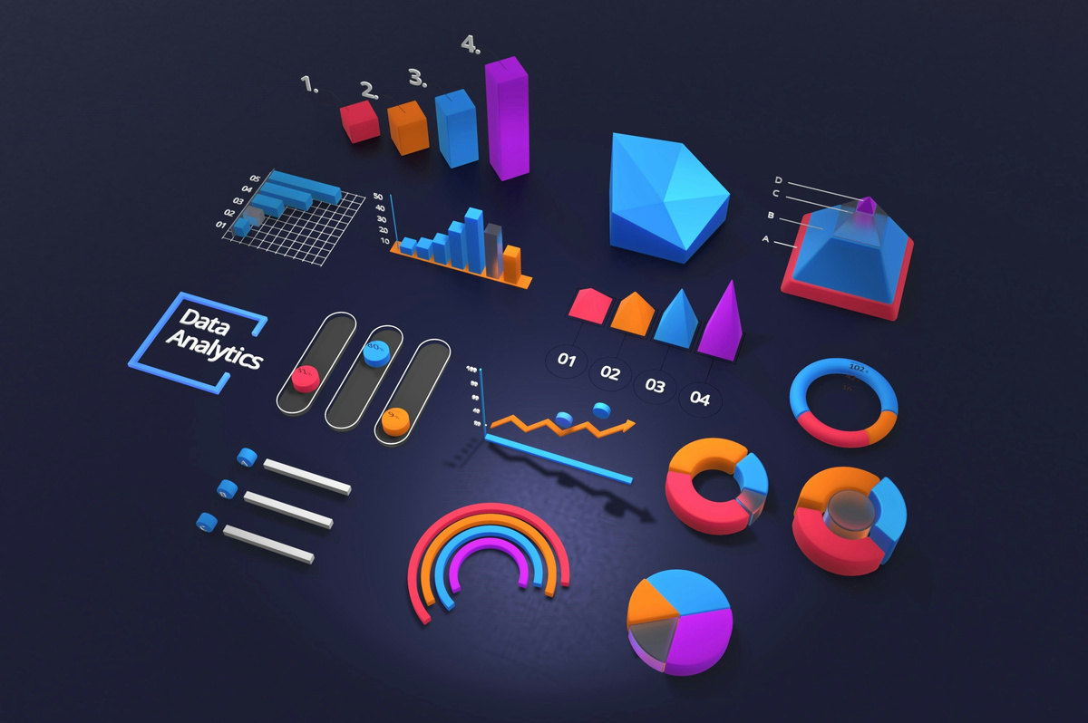
User Interface
📊 Dashboard
View all uploaded models, their status, and usage.
📤 Upload Form
Easily upload models with configurations.
📈 Performance Reports
Visual charts and stats to evaluate model behavior and performance.

Slide 9
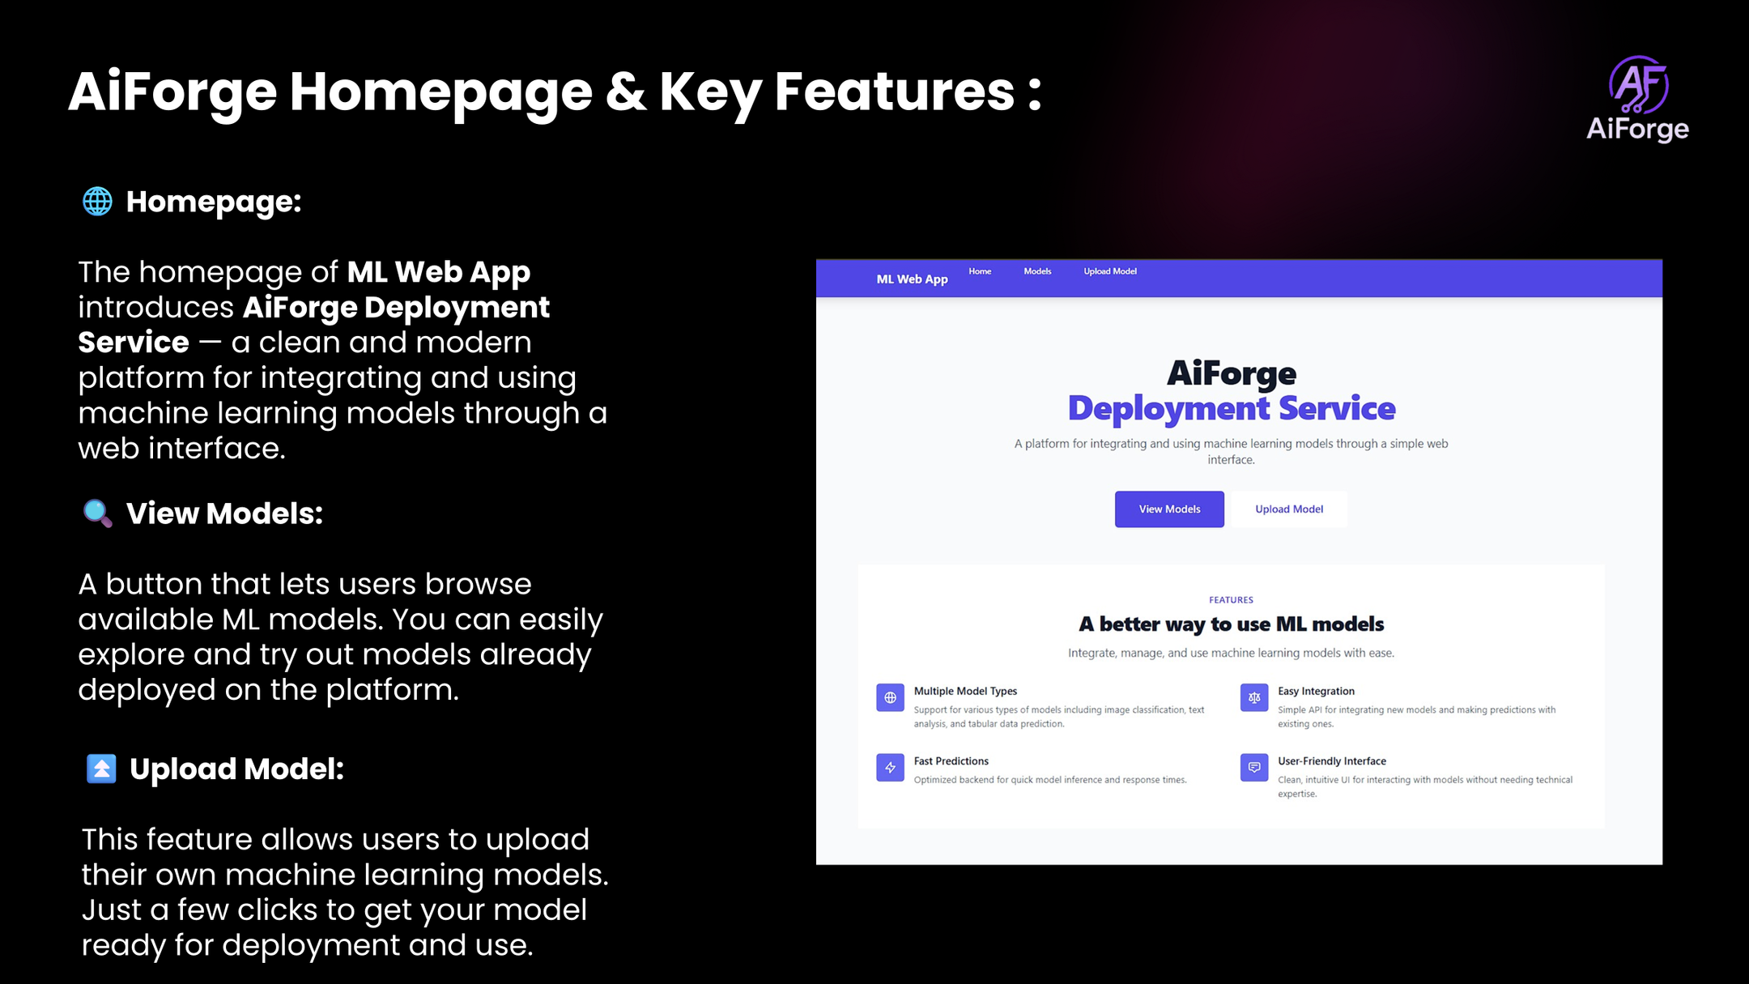

Slide 10


Use Cases
🎓 Universities
Empower students and researchers to deploy models for academic use.
🚀 Startups
Quickly test and deploy models in a secure and scalable environment.
🏢 Enterprises
Centralized solution for sharing and managing ML models across teams.

Slide 11
Prediction Models
🫁 Asthma
🫀
Heart Disease
🍭Diabetes
🌀 Schizophrenia
🤯Hypertension

Slide 12

Diabetes Prediction Model
📊 Key Features
🧠 Models Used
Glucose
BMI
Age
Blood Pressure
Insulin
Logistic Regression (baseline)
Random Forest
XGBoost (best accuracy)
💡 Future Use
Early screening tool
Mobile/web deployment
Add lifestyle factors
⚠️ Limitations
✅ Best Result
Demographic bias
Lab-dependent features
80% Accuracy
Predicts risk based on input data
Example: Glucose=150 → High Risk (80%)
🔍 Goal: Predict diabetes risk using patient health data.

Slide 13

Hypertension model
📊 Key Features
🧠 Models Used
Biometrics
Lifestyle: Sodium intake, activity, smoking
Medical History: Diabetes, cholesterol
Demographics: Age, gender, race
Logistic Regression
Random Forest
XGBoost/LightGBM
💡 Future Use
Early screening tool
Mobile/web deployment
Add lifestyle factors
⚠️ Limitations
✅ Best Result
Self-reported data = potential bias
May miss secondary hypertension causes
Possible demographic underrepresentation
Handles imbalanced data
High accuracy (80–90%)
Regularization prevents overfitting
Feature importance + robust prediction
🔍 Goal: Predict hypertension risk using patient health data.

Slide 14

Heart Disease Prediction Model
📊 Key Features
🧠 Models Used
Blood pressure
Cholesterol
Age
Chest pain type
Exercise-induced angina
Logistic Regression
Random Forest (non-linear patterns)
XGBoost (best accuracy)
💡 Future Use
Early risk screening
Doctor support tools
Add lifestyle/family history
Web/mobile deployment
⚠️ Limitations
✅ Best Result
Clinical data required
Dataset bias (e.g., older adults)
Class imbalance may reduce recall
~80%+ Accuracy
Top predictors reflect cardiovascular risk factors
🔍 Goal: Predict heart disease risk using medical & lifestyle data.

Slide 15
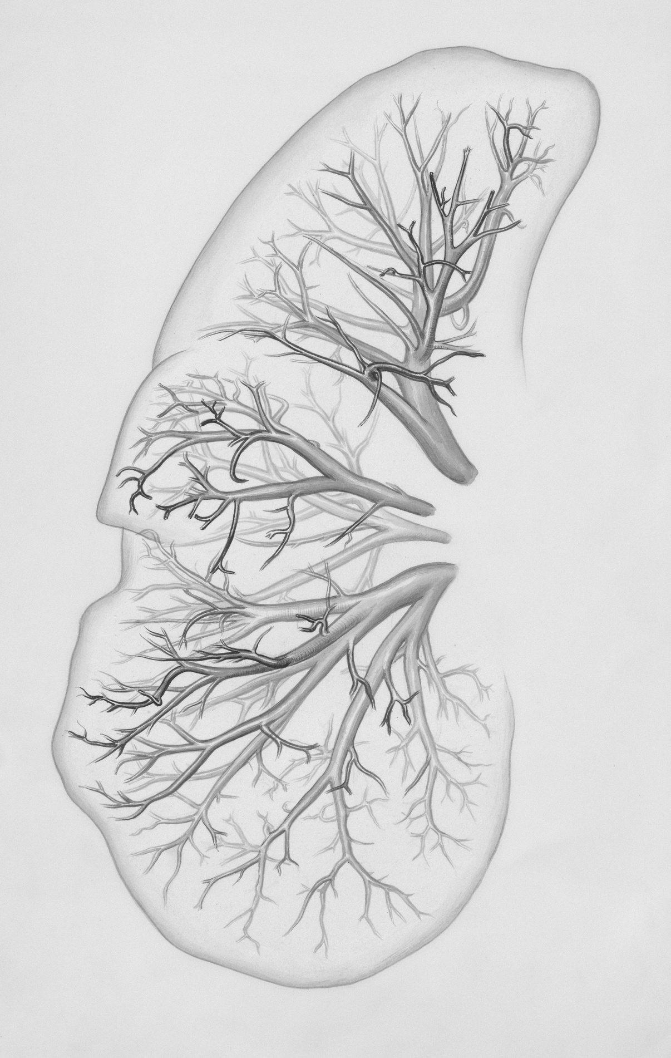
Asthma Prediction Model
📊 Key Features
🧠 Models Used
Physical health days
COPD
Age
BMI
Smoking status
Logistic Regression (85.5% accuracy)
Random Forest (89.4%)
XGBoost (best: 89.6%, F1: 0.43)
💡 Future Use
Public health planning
Risk screening tools
Add environmental & clinical data
⚠️ Limitations
✅ Best Result
Imbalanced data (asthma = 14.5%)
Low recall for asthma cases
Limited to BRFSS variables
89.6% Accuracy
Top features highlight physical + respiratory health risks
🔍 Goal: Predict asthma risk using health survey data.

Slide 16

Schizophrenia
📊 Key Features
🧠 Models Used
Memory & attention scores
Hallucinations, delusions
Family history
Social withdrawal
Logistic Regression (baseline)
Random Forest, XGBoost (handle complex data)
💡 Future Use
High-risk youth screening
Mobile tracking (digital phenotyping)
Clinician-support tools
Multimodal data fusion
⚠️ Limitations
✅ Focus
Rare disorder (~1% prevalence)
Data challenges (missing, sensitive, high-dimensional)
Ethical risks (stigma, misdiagnosis)
Early detection (high recall)
Cognitive & social decline as early signals
🔍 Goal: Predict schizophrenia risk using cognitive, behavioral & clinical data.

Slide 17

AIFrog provides a modern, simple, and
secure way to deploy ML models.
By automating deployment and performance tracking, we help teams
save time and bring their ideas to life—faster than ever before.
Conclusion

Slide 18

Thank You
FOR YOUR ATTENTION

